Slide 1


Where is Last Mile Problem
---Distinguish Last Mile Transit Problems in Urban Areas
Group 3:
Si Chen, Hao Sun, Huajie Shao
Final Project Presentation for CS 565
Date 04/23/2018

Slide 2
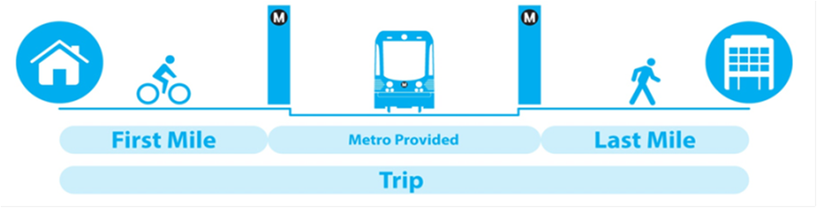
Motivation
Focused Problems:
Last mile in transportation determines the end-chain reaching to homes from public transit stops.
The disconnection between homes and public transit is last mile problem.
Goal:
To develop a last mile (LM) system to find the residential cells that have last mile problem in daily transits based on city public transit network and residential cells’ location.
City of Chicago is chosen to be sample city.
The importance:
The last mile is the first step and the final step of people’s daily commuting.
It directly determine whether the public transit system is accessible for the communities.

Slide 3
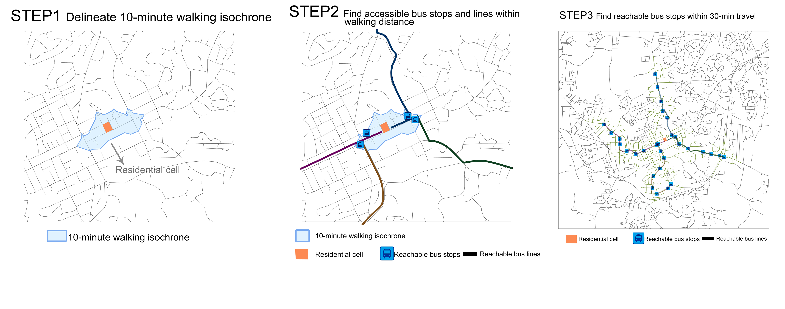
Methodology
Delineate the individual residential cells’ reachable areas through walkable public transit stops
Analyze whether sufficient surrounding popular commuting destinations are covered by each residential cell’s reachable area
Design the threshold to judge which residential cell has last mile problem

Slide 4
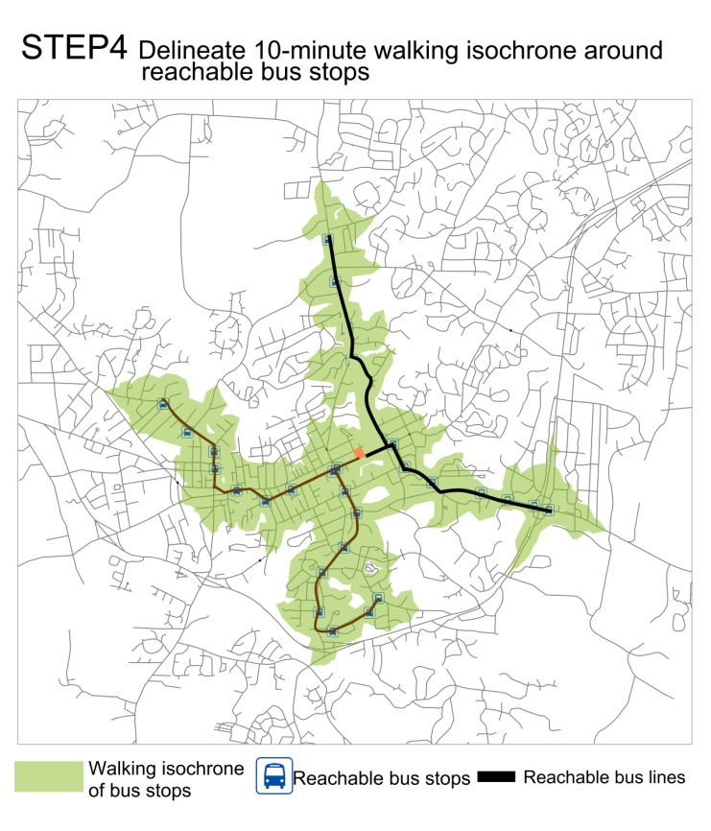
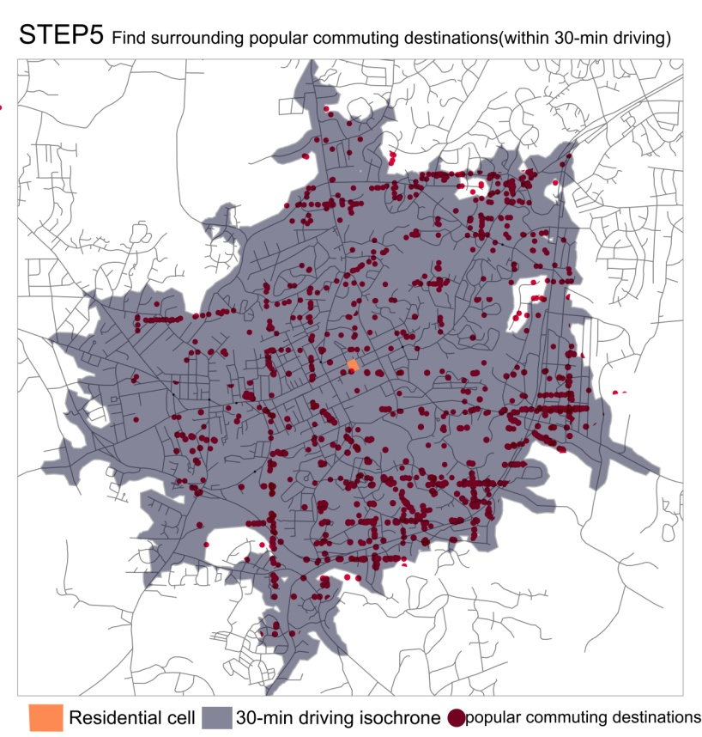
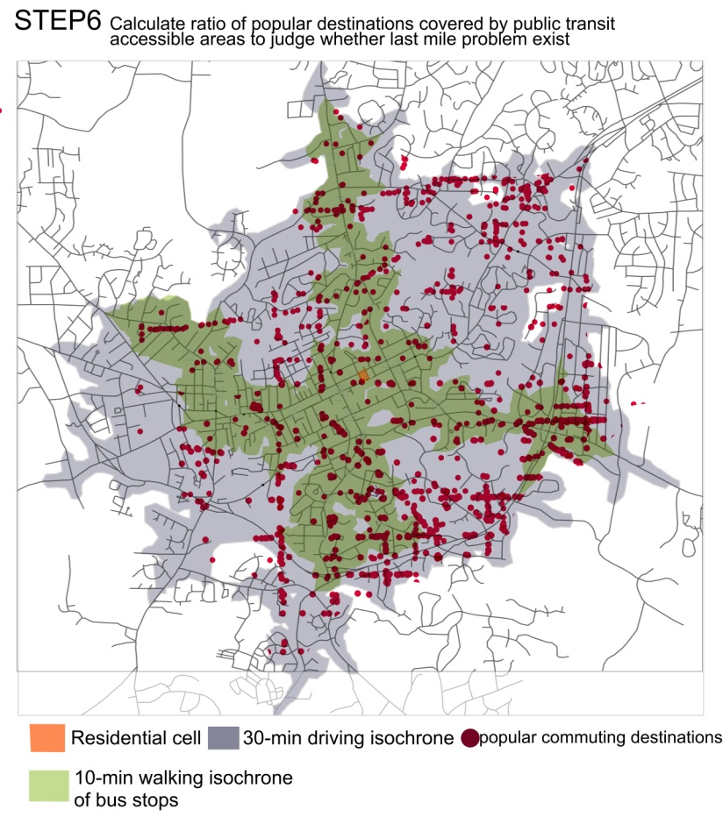
Methodology

Slide 5
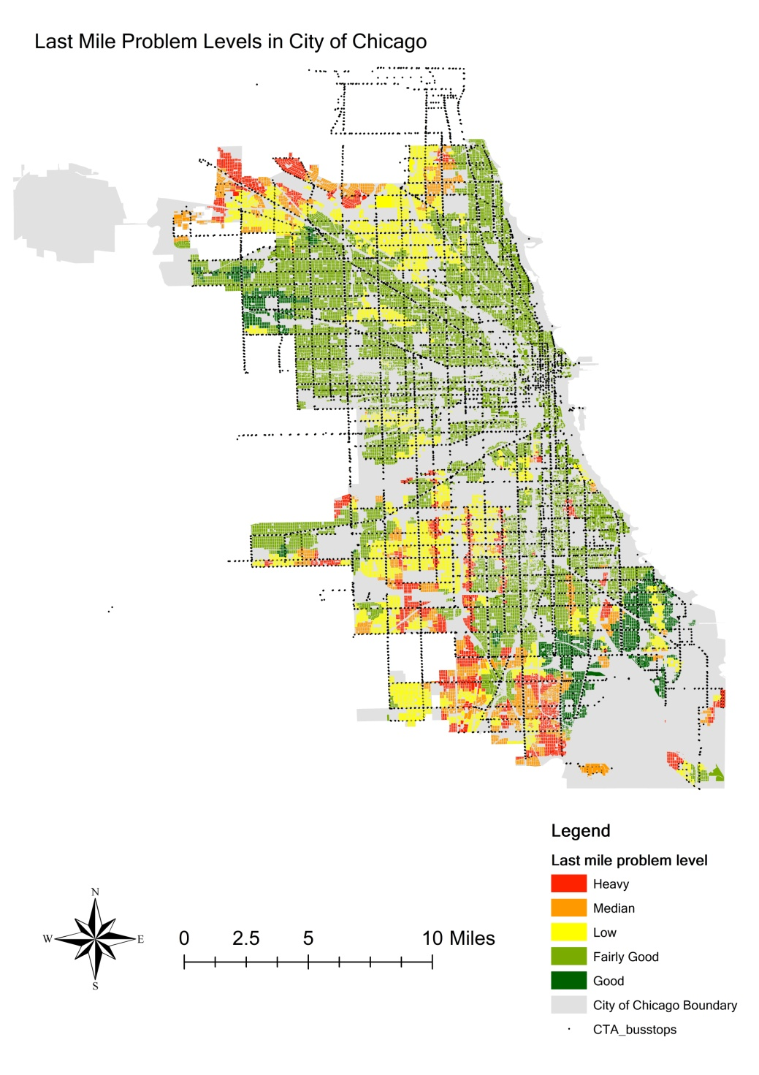
Interface
Display mapped results
LM System Website
Show explanations for last mile maps
Provide discussion board for the users to report undistinguished last mile problems
Applications:
For urban planning professionals to efficiently find the last mile problems in the cities and propose better planning solutions
For citizens to better choose living places
For real estate companies to select developing areas

Slide 6
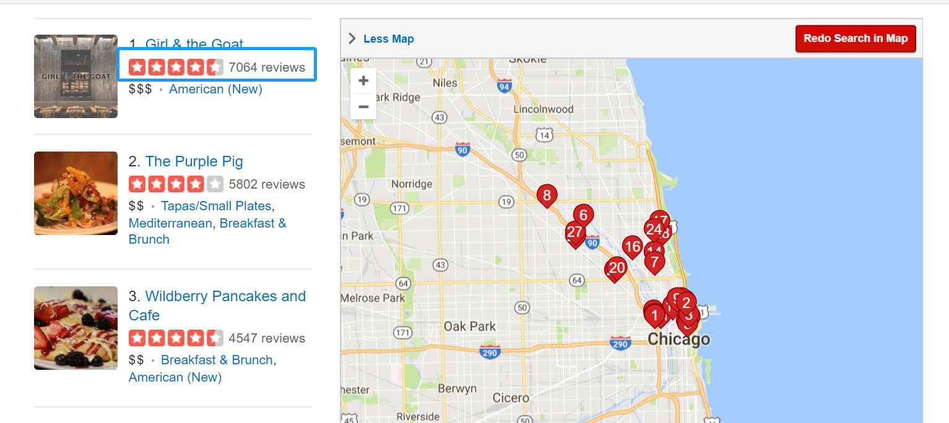
Methodology
Datasets:
1)Yelp dataset is used to find popular commuting destinations based on reviews and ratings.
2)Landuse map extracts the residential cells (where people live)
3)Public transit system data, including bus lines & stops and road networks & speeds for mimicking travelling behaviors
Limitations & Future Work
Do not consider the public subway lines
Do not consider the transfer from one stop to another in public transits
Consider public subway and transfer in the future

